Slide 1
February 1st 1960 - Greensboro, N.C.
Four black students from North Carolina Agricultural and Technical College begin a sit-in at a segregated Woolworth's lunch counter. Although they are refused service, they are allowed to stay at the counter. The event triggers many similar non-violent protests throughout the South. Six months later the original four protesters are served lunch at the same Woolworth's counter. Student sit-ins would be effective throughout the Deep South in integrating parks, swimming pools (swim-ins!), theatres, libraries, and other public facilities.

Slide 2
April 1960 – SNCC formed in Raleigh, N.C.
The Student Nonviolent Coordinating Committee (SNCC) is founded at Shaw University, providing young blacks with a place in the civil rights movement. The SNCC later grows into a more radical organization, especially under the leadership of Stokely Carmichael (1966–1967).

Slide 3
April 16 1963 – MLK arrested
Martin Luther King is arrested and jailed during anti-segregation protests in Birmingham, Ala.; he writes his seminal "Letter from Birmingham Jail," arguing that individuals have the moral duty to disobey unjust laws.

Slide 4
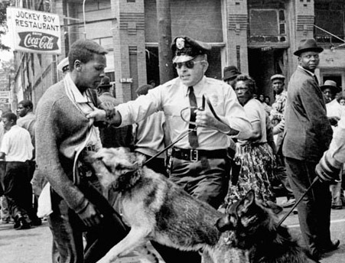
May 1963 - Birmingham
During civil rights protests in Birmingham, Ala., Commissioner of Public Safety Eugene "Bull" Connor uses fire hoses and police dogs on black demonstrators. These images of brutality, which are televised and published widely, are instrumental in gaining sympathy for the civil rights movement around the world

Slide 5
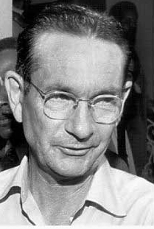
June 12th 1963 – Medgar Evers murdered
Mississippi's NAACP field secretary, 37-year-old Medgar Evers, is murdered outside his home in Jackson, Mississippi. Byron De La Beckwith is tried twice in 1964, both trials resulting in hung juries. Thirty years later he is convicted for murdering Evers.
Beckwith was a white supremacist and member of the KKK

Slide 6
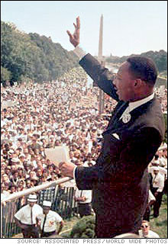
August 28th 1963 – March on Washington for Jobs and Freedom
About 200,000 people join the March on Washington. Congregating at the Lincoln Memorial, participants listen as Martin Luther King delivers his famous "I Have a Dream" speech.

Slide 7
September 15th 1963 – Birmingham Bombing
In Birmingham, Alabama, four young girls (Denise McNair, Cynthia Wesley, Carole Robertson, and Addie Mae Collins) attending Sunday school are killed when a bomb explodes at the Sixteenth Street Baptist Church, a popular location for civil rights meetings. Riots erupt in Birmingham, leading to the deaths of two more black youths

Slide 8
January 23rd 1964 – 24th Amendment
The 24th Amendment abolishes the poll tax, which originally had been instituted in 11 southern states after Reconstruction to make it difficult for poor blacks to vote.

Slide 9
Summer 1964 – Freedom Summer
The Council of Federated Organizations (COFO), a network of civil rights groups that includes CORE and SNCC, launches a massive effort to register black voters during what becomes known as the Freedom Summer. It also sends delegates to the Democratic National Convention to protest—and attempt to unseat—the official all-white Mississippi contingent.

Slide 10
July 2nd 1964 – Civil Rights Act
President Johnson signs the Civil Rights Act of 1964. The most sweeping civil rights legislation since Reconstruction, the Civil Rights Act prohibits discrimination of all kinds based on race, color, religion, or national origin. The law also provides the federal government with the powers to enforce desegregation.

Slide 11
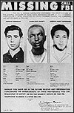
August 4th 1964 – Discovery of Murdered Civil Rights Activists
In Neshoba Country, Mississippi, the bodies of three civil-rights workers—two white, one black—are found in an earthen dam, six weeks into a federal investigation backed by President Johnson. James E. Chaney, 21; Andrew Goodman, 21; and Michael Schwerner, 24, had been working to register black voters in Mississippi, and, on June 21, had gone to investigate the burning of a black church. They were arrested by the police on speeding charges, incarcerated for several hours, and then released after dark into the hands of the Ku Klux Klan, who murdered them.

Slide 12
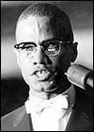
February 21st 1965 – Malcolm X murdered
In Harlem New York, Malcolm X, black nationalist and founder of the Organization of Afro-American Unity, is shot to death. It is believed the assailants are members of the Black Muslim faith, which Malcolm had recently abandoned in favour of orthodox Islam.

Slide 13
March 7th 1965 – Bloody Sunday
In Selma, Alabama, black Americans begin a march to Montgomery in support of voting rights but are stopped at the Pettus Bridge by a police blockade. Fifty marchers are hospitalized after police use tear gas, whips, and clubs against them. The incident is dubbed "Bloody Sunday" by the media. The march is considered the catalyst for pushing through the voting rights act five months later.

Slide 14
August 10th 1965 – Voting Rights Act
Congress passes the Voting Rights Act of 1965, making it easier for Southern blacks to register to vote. Literacy tests, poll taxes, and other such requirements that were used to restrict black voting are made illegal

Slide 15
September 24th 1965 – Executive Order 11246
Asserting that civil rights laws alone are not enough to remedy discrimination, President Johnson issues Executive Order 11246, which enforces affirmative action for the first time. It requires government contractors to "take affirmative action" toward prospective minority employees in all aspects of hiring and employment.

Slide 16
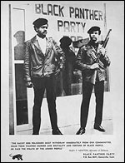
October 1966 – Black Panther Party
In Oakland California, the militant Black Panthers are founded by Huey Newton and Bobby Seale.

Slide 17
April 19th 1965c – Black Power is ‘born’
Stokely Carmichael, a leader of the Student Nonviolent Coordinating Committee (SNCC), coins the phrase "black power" in a speech in Seattle. He defines it as an assertion of black pride and "the coming together of black people to fight for their liberation by any means necessary." The term's radicalism alarms many who believe the civil rights movement's effectiveness and moral authority crucially depend on nonviolent civil disobedience.

Slide 18
June 12th 1967 – Loving vs. Virginia
In a landmark case, the Supreme Court rules that prohibiting interracial marriage is unconstitutional. Sixteen states that still banned interracial marriage at the time are forced to revise their laws, overturning Pace v. Alabama (1883) and ending all race-based legal restrictions on marriage in the United States.

Slide 19
Summer 1965 – Race Riots
Major race riots take place in Newark (July 12–16) and Detroit (July 23–30).

Slide 20
April 4th 1968 – Assassination of Martin Luther King
In Memphis Tennessee, Martin Luther King, at age 39, is shot as he stands on the balcony outside his hotel room. Escaped convict and committed racist James Earl Ray is convicted of the crime.

Slide 21
April 11th 1968 – Civil Rights Act
President Johnson signs the Civil Rights Act of 1968, prohibiting discrimination in the sale, rental, and financing of housing. a landmark part of legislation in the United States that provided for equal housing opportunities regardless of race, creed, or national origin and made it a federal crime to “by force or by threat of force, injure, intimidate, or interfere with anyone … by reason of their race, colour, religion, or national origin.” The Act was signed into law during the King assassination riots by President Lyndon B. Johnson, who had previously signed the Civil Rights Act and Voting Rights Act into law.
Title VIII of the Civil Rights Act of 1968 is commonly known as the Fair Housing Act and was meant as a follow‑up to the Civil Rights Act of 1964. While the Civil Rights Act of 1866 prohibited discrimination in housing, there were no federal enforcement provisions. The 1968 act expanded on previous acts and prohibited discrimination concerning the sale, rental, and financing of housing based on race, religion, national origin, and since 1974, gender; since 1988, the act protects people with disabilities and families with children.

