Slide 1
The Holocaust

Slide 2
Outsiders
There were certain groups who were not part of the VOLKSGEMEINSCHAFT, those who were not deemed part of it were “outsiders”
Socialists/communists- went to the early concentration camps in 1933- but then included anyone from a broader range of political/ideological opponents- Pastor Niemoller

Slide 3
Biologically inferior- covered all races that were inferior or subhuman- Gypies, slavs and Jews, mentally/physically disabled
1933- Law for the Prevention of the Hereditarily Disabled- compulsory sterilisation of those with hereditary conditions- 12 years, 350,000 people were sterilised.
By 1939 this was rolled out even further- Operation T4- Hitler intiated euthanisia for children with servere disabilities-70,000 were gassed in 1940-41- practise for Holocaust

Slide 4
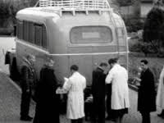

Slide 5
Asocials
Everyone whose behaviour was unacceptable
Alcoholics, prostitutes, criminals, tramps, homeless, workshy- anyone who did not perform for the community
Asocials who were orderly were rounded up and organised into a workforce, disorderly were imprisioned, sterilised or experimented on
Homosexual men were classed as asocials
1936- the Reich Central Office for the Combating of Homosexuality and Abortion was created- sent to camps and made to wear pink triangles- lesbians not treated in the same way as they were not seen as a threat to society

Slide 6
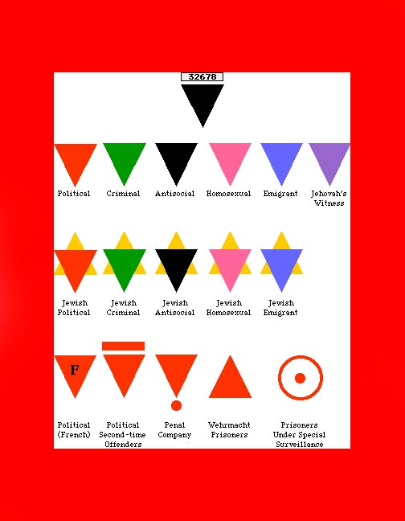

Slide 7
Anti-semitism
Goes back way beyond WW1
Tradition of anti semitism in Europe- Martin Luther
Gradualist approach to anti-semitism in Nazi Germany
Once the apparatus of dictatorship was well established in 1934 people could not risk feeling sympathetic to the Jews due to the risk to one’s own life

Slide 8
Legality
Once dictatorship was legally established they could legally persecute the Jews
See book- 1935- Nuremberg Race Laws
Propaganda against Jews increased – posters, signs, Der Angriff, Der Sturmer, The Eternal Jew Film
Terror and violence- SA, SS, Kristallnact, forced emigration

Slide 9
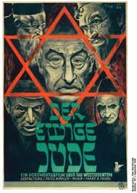

Slide 10
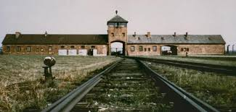

Slide 11
Genocide
Invasion of Poland- millions of Jews- hard to resettle people due to strains of war
Creation of ghettos in Lodz, Warsaw
1941- einsatsgruppen- 4 groups-SS soldiers moved behind advancing armies murdered Jews by mass shootings, 700,000 Jews in Western Russia- Baba Yar

Slide 12
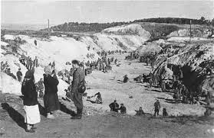

Slide 13
Final Solution
“Final Solution” to the Jewish problem
http://www.youtube.com/watch?v=tPIctGbAZEQ (18 mins) (1:12)
Wannasee conference- Jan 1942- Heydrich & Eichmann – gassing of 11 million Jews
Camps- Auschwitz, Sobibor, Treblinka
Transported by train to gas chambers- from 3 million Jews in Poland only 4000 survived

Slide 14
Gypsies
Sinti & Roma gypsies were subject to racial prejudice and became victims of genocide
Non christian, own Romany customs and dialect
Non white0 originated from India
Traveller lifestyle no regular employment
By 1944 some 225,000 from 500,000 of Europe gypsies had been killed

Slide 15
Intentionalist
Fleming/Dawidowicz Hitler is the key
Committed himself to extermination at an early stage
Gradually policy which led logically to Auschwitz. Holocaust happened as Hitler wanted it to

Slide 16
Goldhagen
Hitler’s Willing Executioners suggests that the Holocaust happened as so many ordinary Germans were prepared to help the Nazi’s darkest deed.
Old argument of “collective national guilt and shame”
However- ignored certain evidence, other countries anti semitism, and role of non Germans in Holocaust

Slide 17
Structuralists
Schleunes- no direct path to the Holocaust, as there was a lack of clear objectives and rival policies. Road to Auschwitz was twisted and not product of grand design
Final solution was the result of choatic nature, but does not reduce the guilt of Hitler himself.

Slide 18
Conclusion
Arrangements were haphazard and makeshift- did not come into being until after 1941
No written order from Hitler- but he encouraged leadership from below as long as in line with his vision

