Slide 1
Weltpolitik and the Navy The naval race with Britain and worsening relations

Slide 2
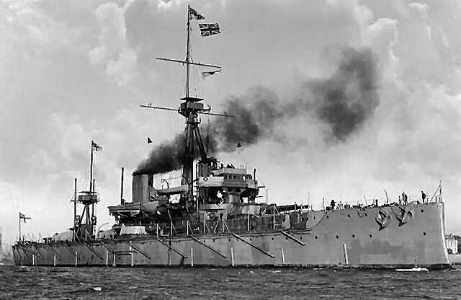
Connector

Slide 3
Outcomes
All to know what the arms race was and it position in Germany foreign policy
Most to research what happened
Some to see how this will effect the causes of the First World War

Slide 4
Why a navy?
Britain had naval supremacy in the world
To protect its empire
To protect trade around the empire
As a deterrent to other nations
Britain also has a rich naval traditional

Slide 5
Germany
A rising sense of nationalism was partly behind the building of Germany’s new navy
There was even a Navy League pressure group with nearly a million members
The sense of nationalism also spilled over into foreign policy
They hoped that this would help overcome domestic opposition
However this left Germany dangerously encircled by 1914 due to ill thought out expansionist policies

Slide 6
German Empire-confused?
Some wanted to explore parts of Africa and Far East, although some wanted to expand to the Balkans, China and South America
Others wanted to expand eastwards into Poland and Russia to create a huge trading bloc
Above all was the Kaiser who wanted to oversee a German empire under his leadership
Standing in his way was Britain already with an established empire and navy

Slide 7
Germany & Britain
Despite his English visits the Kaiser was bitterly jealous of Britain and openly hostile towards it
To achieve parity with Britain's empire they believed they would first have to challenge British naval supremacy
At the same time they believed that a strong German navy would force the British into accommodation or diplomacy with Britain

Slide 8
The Naval Challange
Admiral von Turpitz shared the Kaisers belief that Germany should mount a naval challenge to Britain through the creation of a battleship fleet
It would also provide jobs and a market for the new steel works of Germany
It would unify the country, embrace patriotism and nationalism, resolve social tensions and signify Germany’s bid to become a world power

Slide 9
Navy Laws
1898-It authorised the maintenance of a fleet of 19 battleships, 8 armoured cruisers, 12 large cruisers and 30 light cruisers to be constructed by 1 April 1904. Existing ships were counted in the total, but the bill provided for ships to be replaced every 25 years on an indefinite basis. Five million GM annually was allocated to run the navy, with a total budget of 408 million GM for shipbuilding.

Slide 10
1900 Navy Law
1900-This approximately doubled the allocated number of ships to 38 battleships, 20 armoured cruisers, 38 light cruisers.
Significantly, the bill set no overall cost limit for the building program.
Expenditure for the navy was too great to be met from taxation
Reichstag had limited powers to extend taxation without entering into negotiations with the constituent German states, and this was considered politically unviable.
Instead, the bill was financed by massive loans.
Tirpitz, in 1899 was already exploring the possibilities for extending the battleship total to 45, a target which rose to 48 by 1909.

Slide 11
But....
Germany failed to second guess Britain’s response
Britain’s naval policy was to have a navy that was larger than the two other largest fleets in the world combined
British intelligence estimated that Germany would have the second largest fleet in the world by 1906

Slide 12
Task: The Arms Race
This now led to an arms race
Research
What was a dreadnought?
How many ships were built
The cost of the arms race
http://www.clickview.com.au/LinkStart/?videoid=786&videochapterid=8172

Slide 13
Find out what the following was and make notes
The Jameson raid -1896
“splendid isolation”
Mittelafrika/Mitteleuropa
Who said
“we have to put no one in the shade, but we too demand our place in the sun”
Zabern Affair
Daily Telegraph Affair

Slide 14
Review
What would be the knock on effects of the arms race
Discuss

