Slide 1
Nazi Germany
How Successful was Nazi Propaganda?
These icons indicate that teacher’s notes or useful web addresses are available in the Notes Page.
This icon indicates that the slide contains activities created in Flash. These activities are not editable.
For more detailed instructions, see the Getting Started presentation.
1 of 18
© Boardworks Ltd 2006

Slide 2
Introduction

Slide 3
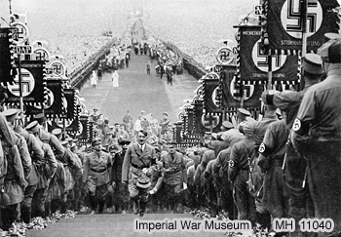
Propaganda
Photograph courtesy of the Imperial War Museum, London.
This picture shows Hitler ascending to the speaker’s podium at the 1934 Nuremburg rally.
What kind of effect do you think this spectacle had on ordinary Germans who attended?
Notes:
Hitler, flanked by the massed ranks of the Sturmabteilung (SA), ascends the steps to the speaker's podium during the 1934 Nazi Party Rally at Nuremberg.

Slide 4
What is propaganda?
Propaganda is best thought of as being ‘political advertising’. It is designed to get people to think and believe what you want them to.
For the Nazis, this involved:
persuading Germans to believe in Nazi ideas and love their Führer
convincing those hostile to the regime that the Nazis were so powerful that opposition would be futile.
Propaganda has been widely used by governments to distort facts, maintain popularity and boost morale.
Are there any circumstances in which a government could legitimately use propaganda?

Slide 5
Censorship
Alongside their propaganda machine, the Nazis practised strict censorship. People who disagreed with Nazi ideas were silenced.
In order to get any work published or performed in Nazi Germany, you had to be a member of the Reich Chamber of Culture. Writers, film makers and artists were denied membership if their views were un-Nazi.
Books which did not fit in with Nazi doctrine were publicly burnt.
Essentially, the Nazis controlled everything that the German people read, heard and saw.

Slide 6
The Arts
Painting, Architecture and Literature

Slide 7
Hitler and the arts

Slide 8
Broadcasting
Newspapers, Radio, Film

Slide 9
Newspapers
Notes:
Teachers could, of course, design an A3 grid which students could fill in, with each row of the table representing a different theme, each column one of the four key options.

Slide 10
Radio

Slide 11
Film

Slide 12
Conclusion
Evidence of success:
In the short term, propaganda played an important role in getting Hitler into power and then advertising his main ideas. The general lack of resistance to the Nazi regime is an important indication that propaganda was effective.
For young people, propaganda had a lasting effect. Despite the loss of World War II, a poll conducted by the USA in October 1945 showed that 42% of German youths believed that reconstruction would best be carried out by a ‘strong new Führer’.

