Slide 1
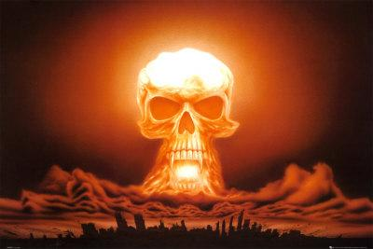
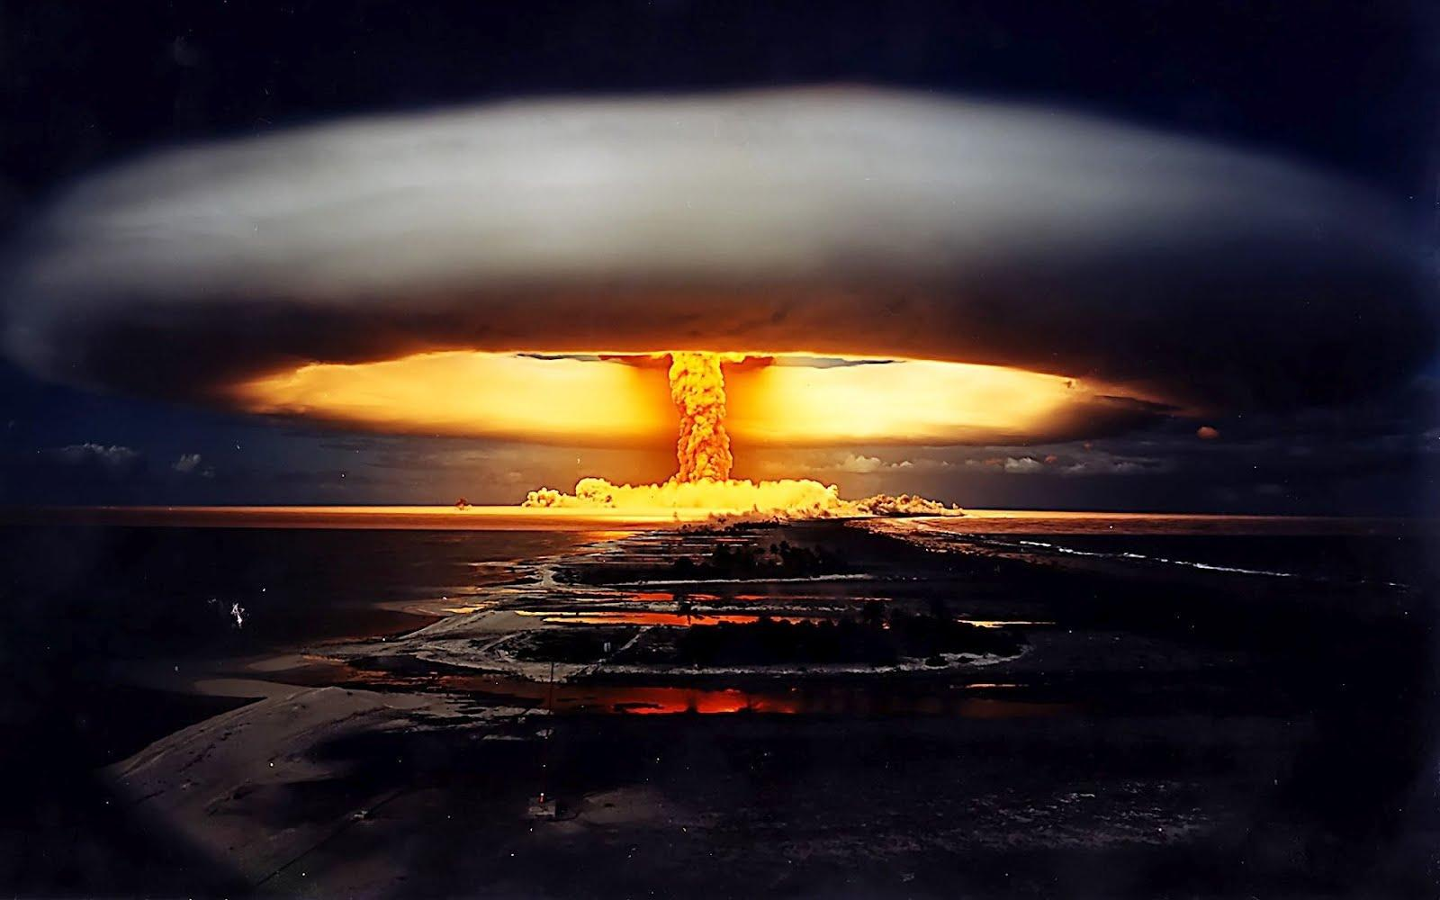
NATO & Warsaw Pact, Arms Race & Military Development
By:
Vikram Jain, Dawood Pervez, Sultan Iqbal and Maninderjit Bal

Slide 2
NATO (North Atlantic Treaty Organisation)
- The Berlin Blockade and Airlift showed the Allies that war with the USSR was possible. In April 1949 they decided to form the North Atlantic Treaty Organisation (NATO).
- During the Berlin Blockade, the USA had become concerned about the military power of the USSR in Europe and is also a reason why NATO was set up - to counter the threat.
- NATO countries (USA, GB, France, Portugal, Italy) agreed to help each other militarily. The members of NATO made it clear that any attack on any part of their territories would be considered an attack on the whole alliance.
- NATO led to US troops and aircraft being stationed in European countries to protect them against a possible attack by the countries of Eastern Europe.

Slide 3
Warsaw Pact
- Although, The Warsaw Pact was formed five years after NATO, it was a response to the treaty made by the western allies in the Trizonia (the North Atlantic Treaty Organisation, or NATO). The NATO constituted a system of collective defence whereby its member states agreed to mutually defend and provide military support in response to any attack by any external party including USSR. These posed a potential threat to the USSR and the eastern communist countries. The countries that signed were Albania, Bulgaria, Czechoslovakia, East Germany, Hungary, Poland, Romania and Soviet Union.
- It was a military treaty which bound its signatories to provide military aid to any communist country who became the victim of foreign aggression. Although it was stressed by all that the Warsaw Treaty was based on total equality of each nation and mutual non-interference in one another's internal affairs, the Pact quickly became a powerful political tool for the Soviet Union to hold sway over its allies and harness the powers of their combined military as in the Hungarian Uprising.
- Though its overall military capability was never challenged by NATO as neither side ever fought the other, the pact acted as a strong defence figurehead for NATO.

Slide 4
Statistics of NATO against Warsaw Pact
In 1967, China exploded an H-bomb. China was a communist country. In the west, NATO felt outnumbered and so had to place faith in nuclear missiles.
Troops :
NATO 2.6m
Warsaw Pact 4m
Tanks :
NATO 13,000 Warsaw Pact 42,500
Artillery :
NATO 10,750.
Warsaw Pact 31,5000

Slide 5
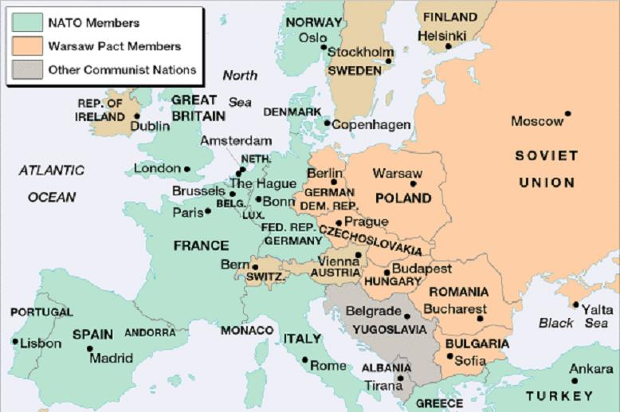
NATO & Warsaw Pact Countries

Slide 6
The Arms Race (Post-WW2)
After World War Two, the USA and USSR were the major world superpowers.
The USA and USSR became very competitive, trying to outdo each other in every way, including numbers and quality of atomic weapons and delivery systems for them. Each wanted to be the strongest, and always felt threatened by the other and went into an arms race. The fact that their ideologies were virtually opposites only added to the tension and drove each to try harder.

Slide 7
Post-WW2 US Military Developments
Germany had surrendered in May 1945, but the war against Japan continued. In August 1945, the USA dropped two atom bombs (which it had kept secret from the USSR) on Japan, destroying Nagasaki and Hiroshima. Japan surrendered immediately. However, the USSR was saw this as the USA showing its power, as arguably, Japan would have been defeated anyway, and so it was seen as unnecessary, and more of a warning, or a show of power to the USSR, which geographically, is very close to Japan.

Slide 8
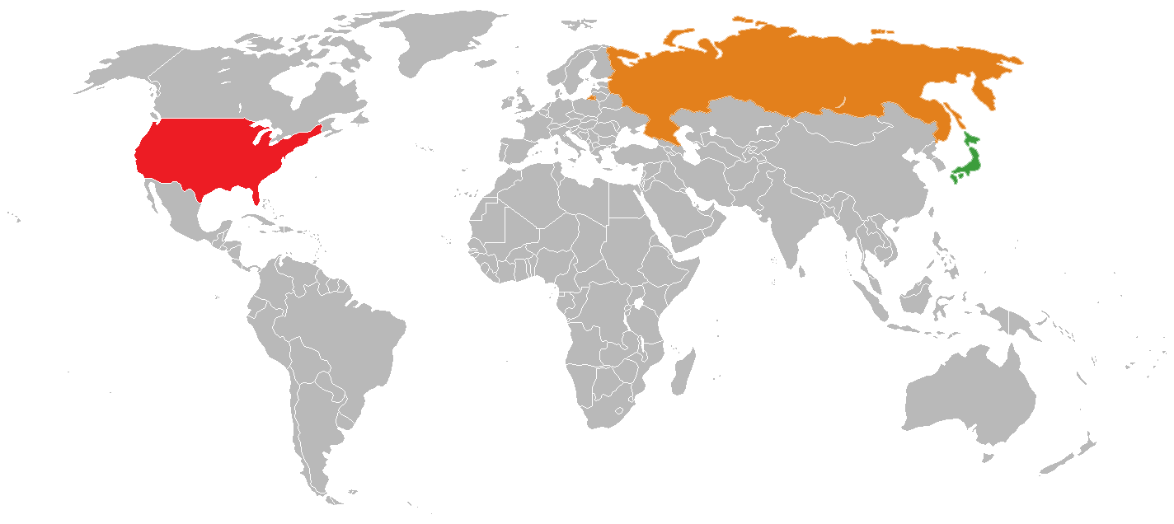
USA, USSR and Japan

Slide 9
Post- WW2 USSR Military Developments
The Atom Bomb (A-bomb) had been kept a secret from the USSR until just before their use on Japan. After this, for the next four year, the USA was the world's only nuclear power.
By 1949, the USSR had exploded their own A-bomb. The USA developed the even more powerful hydrogen bomb (H-bomb) in 1952.The USSR once again followed with theirs in 1955.

Slide 10
The Nuclear Arms Race (ICBM)
The arms race continued through the 1950's and 1960's. In 1957, the USSR test-fired the first ever Intercontinental Ballistic Missile (ICBM), and also launched Sputnik 1, the world's first artificial satellite.
This new technology frightened the west, as it was clearly possible to launch a nuclear attack on the USA from the USSR. But the USA soon made advances. In 1957 it launched the Atlas ICBM, and in 1960 the Polaris submarine-launched ICBM.
The number of American ICBMs increase from 200 in 1961 to 1000 in 1967. However, the USSR once again started to catch up to the USA when some resources were diverted to the Vietnam War. Both now had the potential to do horrendous damage, and destroy each other many times over.

Slide 11
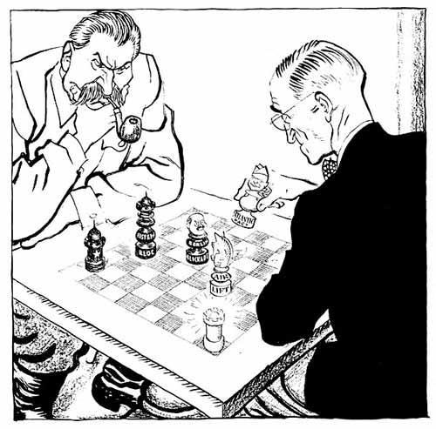
Activity
Write an analysis of the political cartoon. (What is it suggesting/showing us about the intentions or plans of each side)
AND
Answer one question from each of the two sections from the question sheet.

