Slide 1
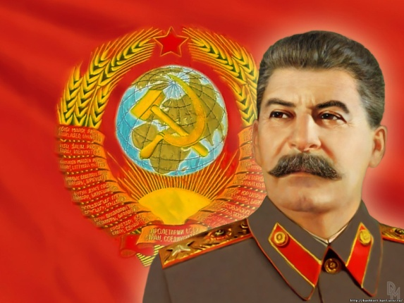
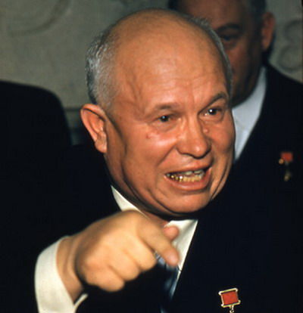
The Hungarian Uprising
Completed by Jatinder Ram
11F1
History
UNIT 4

Slide 2
What exactly is meant by the term “the Hungarian Uprising”.
Brief Note:
The historical term of the “Hungarian Uprising” was named after the series of significant events which forever changed Hungary during the “Cold” War.
For one, Hungary had been controlled by Russia since 1945.
On saying this, the death of Stalin brought people in many Eastern European countries; the hope of pure freedom and change.
Nevertheless, as the 1956 uprising in Hungary proved, this was not, however to be the case.

Slide 3
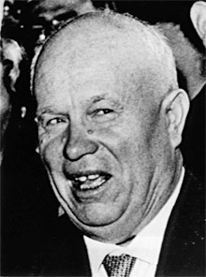
Series of events which took place after the death of Joseph Stalin.
The death of Stalin was a controversial turning point; not only was he a strong ruthless leader, however he had been the USSR’s leader since the very 1920s.
As a result, the Soviet Policy seemed to change under the new leader, known to many as ‘Khrushchev’
He was exceptionally critical of Stalin, and his previous policies seemed less harsh nevertheless – Therefore, this became known as the “thaw” of the Cold War.

Slide 4
Khrushchev – A leader with many attributions.
This particular type of man was in favour of peaceful coexistence between both capitalist and communist states.
He was extraordinarily clever, and made gestures of friendship to the USA.
In 1959, he became the 1st leader of the USSR to visit the USA.
He also kindly freed prisoners, thus reduced censorship in the USSR.

Slide 5
Video explanation of the Hungarian Uprising – Watch and reflect...
http://www.youtube.com/watch?v=1O_dv7n53ok&feature=relmfu
Reflect on the video you have just witnessed. Take a minute.

Slide 6
Educational video summarizing the Hungarian Uprising.
http://www.youtube.com/watch?v=iieoMQe2fHg
Nézd meg ezt a nagyon tanulságos videó, és tükrözik a körülmények Magyarország szembesült során 1956.

Slide 7
Towards the narrow ending of the Hungarian Uprising -Soviet Tanks Invaded Hungary.
During the Hungarian revolution, a horrifying 20 000 Hungarians were murdered.
Imre Nagy (who was a Hungarian communist politician who was appointed Chairman of the Council of Ministers of the People's Republic of Hungary on two occasions) was arrested and later, shot.
Kadar became PM and ensured loyalty towards USSR.
Western Countries did not come to Hungary’s aid. Also, the incident showed that despite the “thaw” in policy, Khrushchev could still in fact be harsh

Slide 8
Long term effects of Hungarian Uprising
Repression in Hungary - thousands of Hungarians were arrested and imprisoned. Some were executed and 200,000 Hungarian refugees fled to Austria.
Russia stayed in control behind the Iron Curtain - no other country tried to get rid of Russia troops until Czechoslovakia in 1968.
Polarisation of the Cold War - people in the West were horrified - many Communists left the Communist Party - and Western leaders became more determined to contain communism

Slide 9
Quiz. (A*) – (Select 1 answer)
1. Which of the following was not a cause of the Hungarian revolution of 1956?
- Hungarian Radio - The communist repression of the Catholic Church -Khrushchev's policy of "destalinisation“
2. How many Russian tanks were sent into Hungary?
1,000 10,000 100,000 9. How many Hungarians were killed in the revolution?
4,000 30,000 200,000

Slide 10
Congratulations
10 Positive Points to those who answered 3 correctly! Well done! Good knowledge of the topic!
To summarize – Please watch this final clip:
http://www.youtube.com/watch?v=554ZJUv-avQ&feature=related

Slide 11
Thank you,
Jatinder Ram
Jaswant Virk
Mustafa Jameel

