Slide 1
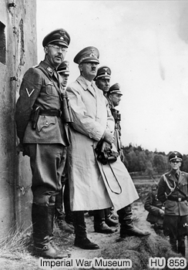
Moving forward: the police state
Very quickly, Hitler placed his party at the heart of the government of the country. Key to this was setting up an effective police state.
The regular police – the Ordnungspolizei (ORPO) – was put under the control of Himmler who already ran the SS (Hitler’s personal body guards).
In 1933, the Gestapo (Secret State Police) was set up. The Gestapo used agents and informants to find and arrest anyone hostile to the Nazis government.
Photograph courtesy of the Imperial War Museum, London.
Jews, beggars and gypsies were arrested as well as political opponents. So many people were imprisoned that special concentration camps had to be set up to house them.
Notes:
The photograph shows Hitler and Heinrich Himmler watching SS troop manoeuvres in 1939.

Slide 2
Moving forward: the police state
Can you complete this table on the Nazi police state?

